Slide 1
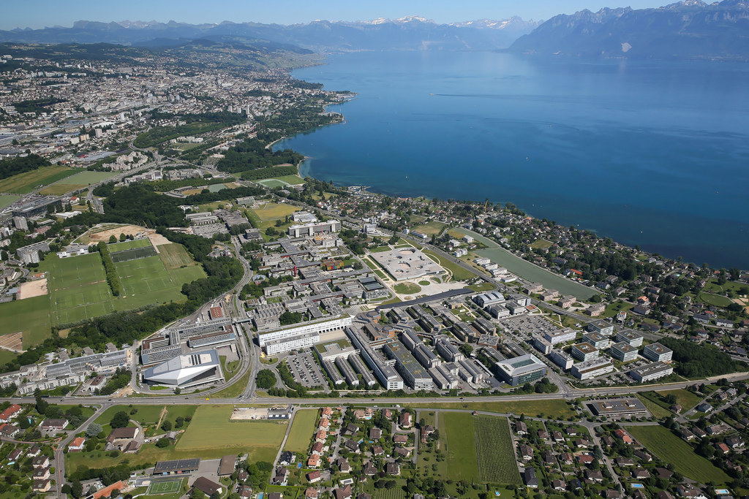
Charaterization of viscoelastic materials
Véronique Michaud
CCMX Advanced Materials Characterization,
August 24, 2023

Slide 2

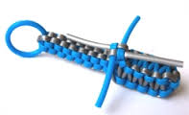
Goal of this course
Introduction: what is viscoelasticity, where do we see it?
Definitions
Theory: simple models, Boltzmann superposition
Measurement methods: creep, oscillatory mode, other methods with practical examples

Slide 3
Introduction
Viscoelastic materials: materials for which the relation between stress and strain depends on time.
Anelastic/linear viscoelastic solids: a subset of viscoelastic materials that recover fully after removal of a transient load.
Phenomena:
Cases of constant stress, strain increases with t: creep
Cases of constant strain, stress decreases with t: relaxation
Cases where effective stiffness depends on loading rate
In cyclic loading, the response is not in phase with the sollicitation, leading to mechanical energy dissipation.
Attenuation of acoustic waves
Incomplete rebound, added friction…

Slide 4
Introduction
Example of viscoelastic materials:
Metals at high temperature, due to increased diffusion rate, or lead and solders at low temperature
Polymers, elastomers
Wood
Human tissues: ligaments, tendons, bone, skin
Geological materials
Implications:
Problems: long term performance of structural materials, change in shape or stress with time…
Benefits: impact absorption, dampers, shoe soles, sealing plugs,..

Slide 5
Definitions
Creep
Relaxation

Slide 6
Definitions
Recovery: evolution after the stress (or strain) is removed. For a linear elastic case, the recovery tends to zero after a certain time.

Slide 7
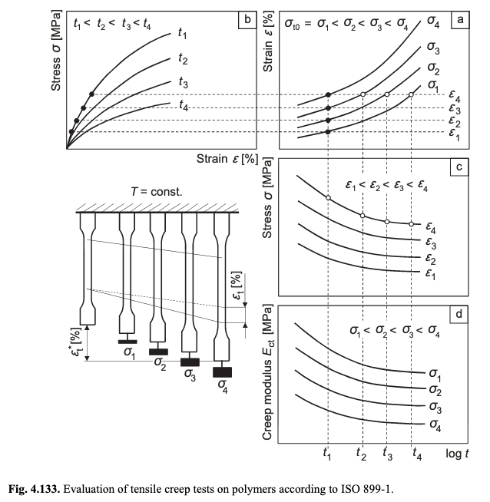
A simple method for creep characterization
Material under constant load:
It is possible to extract
a creep modulus, by dividing
the stress by strain at time t, to find an experimental function to identify, i.e. a Creep modulus for a given stress level and time.
E_{c}(t)=σ₀/ε(t)
Long-term loading – Compression Creep Test – Introduction, January 2014, DOI: 10.1007/978-3-642-55166-6_60
In book: Polymer Solids and Polymer Melts–Mechanical and Thermomechanical Properties of Polymers Christian Bierögel, Wolfgang Grellmann

Slide 8
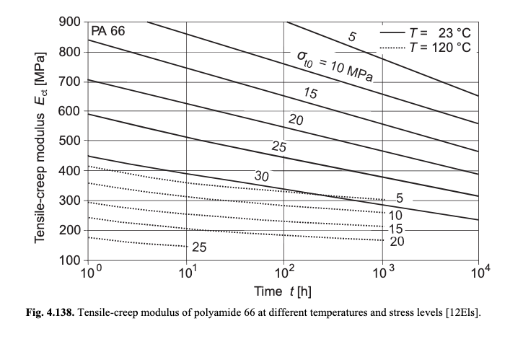
Example of tensile creep characterization for a Polyamide 6,6
Long-term loading – Compression Creep Test – Introduction, January 2014, DOI: 10.1007/978-3-642-55166-6_60
In book: Polymer Solids and Polymer Melts–Mechanical and Thermomechanical Properties of Polymers Christian Bierögel, Wolfgang Grellmann

Slide 9
Theoretical constitutive equations
Need to predict and model the viscoelastic behavior: for small deformations, linear viscoelasticity describes well the behavior, with total recovery.
Ideally, we need to have a constitutive equation describing the relation between stress and strain, for the form Pσ=Qε

Slide 10
Mechanistic models
Maxwell model
Kelvin model

Slide 11
Mechanistic models

Slide 12
Mechanistic models
Standard Linear Solid Model
Creep
Relaxation
Compliance function:
Relaxation function:

Slide 13
Mechanistic models
Any combination of Maxwell or Kelvin elements is also possible

Slide 14
Last bit on theory: Boltzmann superposition
Valid for linear viscoelastic materials, small deformations: the effect of a compound cause is the sum of the effects of the individual causes
ε(t)=σ₁J(t - t₁) for t₁ < t < t₂
ε(t)=σ₁J(t - t₁) + σ₂J(t - t₂) for t>t₂
For very small increments: Similarly for stress:

Slide 15
Summary for the models
For any solicitation in stress, strain is found as:
For any solicitation in strain, stress is found as:
So, for prediction of behavior, we need to identify the functions J and R characterizing the material, then we can take care of all types of material history.

Slide 16
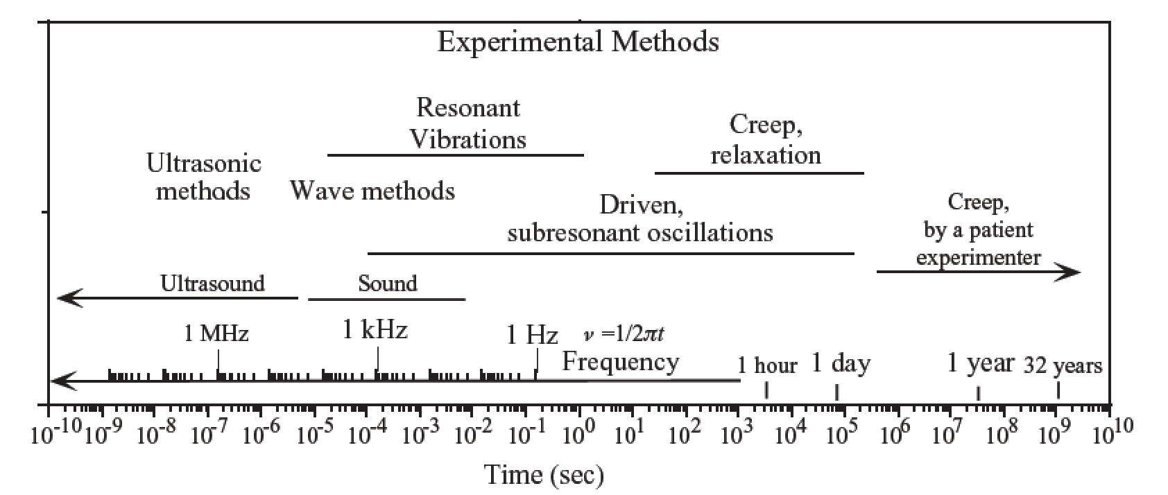
Characterization methods
Mechanical tests are mostly used: force or torque is applied, and strain is measured versus t. The tests are either static, or dynamic with oscillatory stress or strain. To explore wide ranges of time or frequency, some tricks have been devised (time temperature equivalence), or several methods are used.
From Lakes, 2009

Slide 17
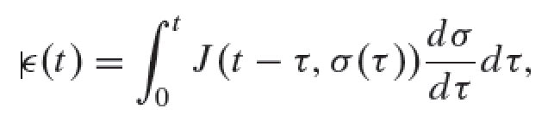
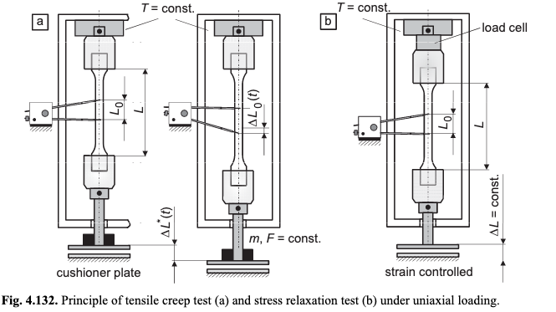
Creep, relaxation
Constant stress applied with calibrated dead weights, levers or hydraulic systems for stiff materials (concrete). Specimens of biological origin or some polymers need to be preconditioned by cycling first to obtain reproducible results.
Issues: long time needed to cover several decades (11 days for 5 decades), and caution to ensure proper gripping for uniform stress
Possible to measure nonlinear viscoelasticity: creep at various stress levels, followed by recovery.
In case of Quasi Linear viscoelasticity, J(t, σ)=J(t) f(σ)
Strain measurement is performed using LVDT, extensometer or strain gauges

Slide 18
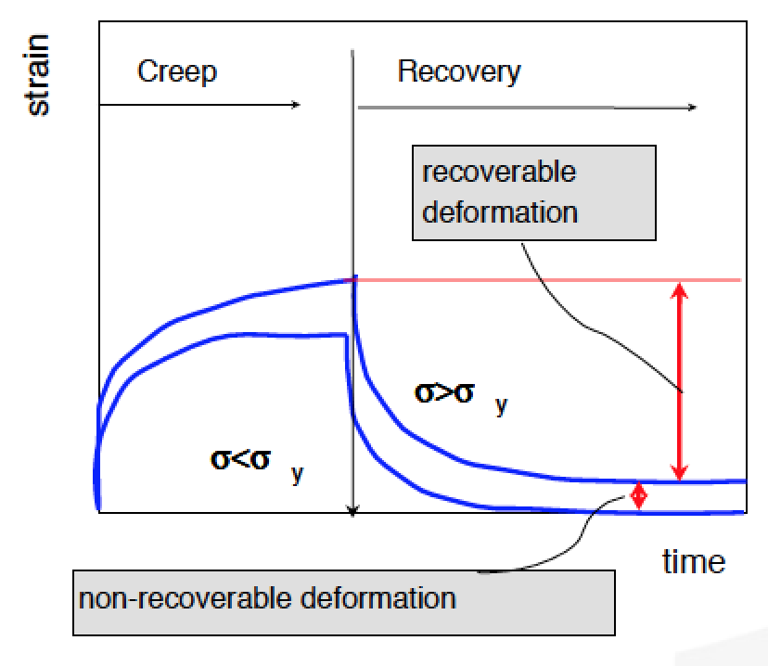
Creep/Recovery experiments
Above a certain level of stress, the material is irreversibly deformed (“plastic deformation”) and the recovery is not full.
Succesive creep/recovery tests are needed to determine the threshold stress
From TA instruments slides

Slide 19
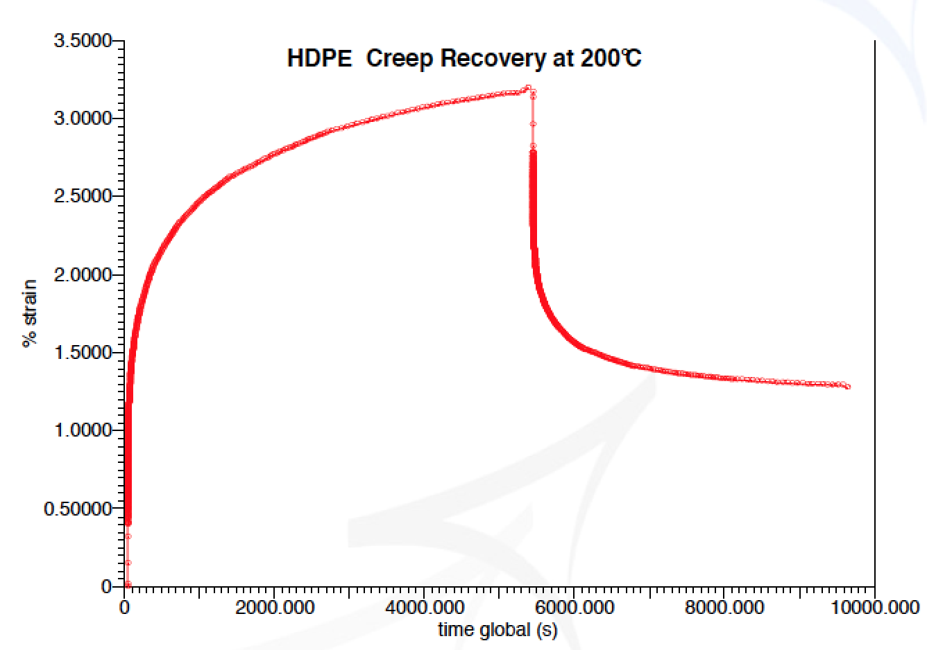
Creep/Recovery experiments
EXAMPLE: HDPE
From TA instruments slides

Slide 20
Creep at room temperature
Example: Creep of Polypropylene at room temperature
Linear viscoelastic

Slide 21
Issues with creep/recovery measurements
Find the right stress, if too high, no creep but plastic flow, if too low, the strain may be too low to measure and the experiments takes too long.
A trick that works for materials for which viscoelasticity is thermally activated ( i.e. many materials) is to perform tests at various temperatures, and then perform at time-temperature superposition.

Slide 22
Time-temperature superposition
Defining a_{T} the shift factor, we can then identify the R(t) function for several temperatures.

Slide 23
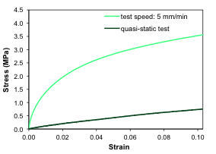
Static tests at various testing speed
With a simple tensile testing or compression testing equipment, it is possible to test materials at various speed to assess the effect of strain rate on the apparent properties.
Example of a low modulus epoxy resin, stress strain curve as a function of testing speed.

Slide 24
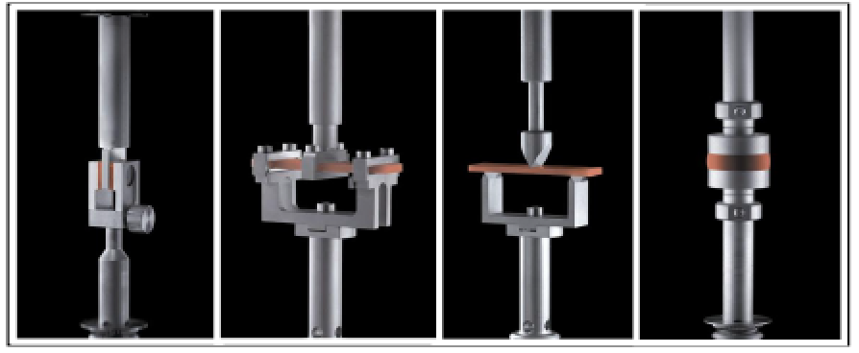
Oscillatory measurements
Sub resonant dynamic method: imposed oscillatory stress or strain to a sample, and the resulting strain or stress is measured.
This technique is very often used for polymers, composites, any material where the phase angle is rather large.
It is very practical as several parameters can be adjusted: stress or strain amplitude, frequency, temperature.
Solicitations can be in tensile mode, in bending mode, in shear depending on the apparatus.
From TA instruments slides

Slide 25
Oscillatory measurements-principle
Elastic material:
ε = ε ₀ sin(ω t) σ = σ ₀ sin(ω t)
Viscous material:
= ε ₀ sin(ω t) σ = σ ₀ sin(ω t+π/2)
because σ=η dε/dt

Slide 26
Oscillatory measurements-principle
Viscoelastic material:
ε = ε ₀ sin(ω t) σ = σ ₀ sin(ω t+δ)
δ is the phase angle
Definitions:
Storage modulus
Loss modulus
Then, phase angle
So, finally:

Slide 27
Moduli for a SLSM model material
E’ increases with frequency, and E’’ passes through a maximum when the angular velocity corresponds to the characteristic time of the system.

Slide 28
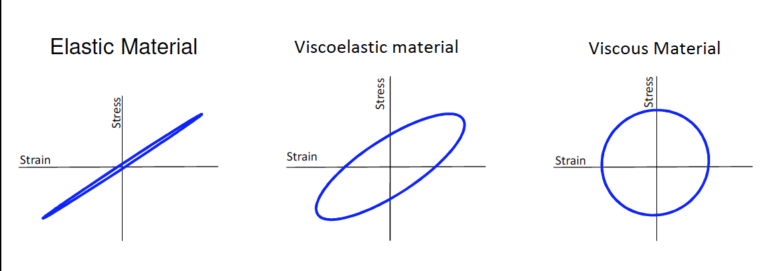
Lissajous curves
Plotting the stress versus strain parametric curves, an ellipse is obtained.
The dissipated energy is:
So, for a solicitation in strain, counting negative energy when it is dissipated:
In stress:

Slide 29
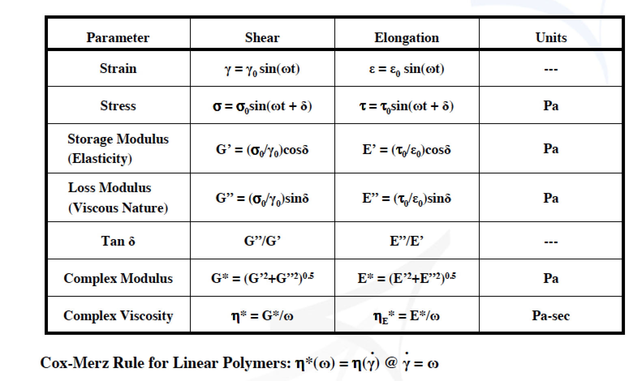
Summary
From TA instruments slides

Slide 30
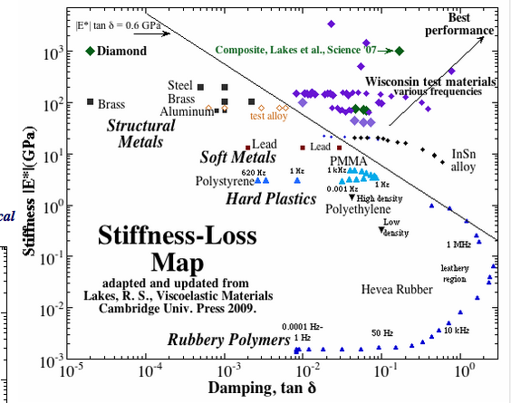
Stiffness loss maps for several materials
NiMnGacomposites
From Lakes, 2009

Slide 31
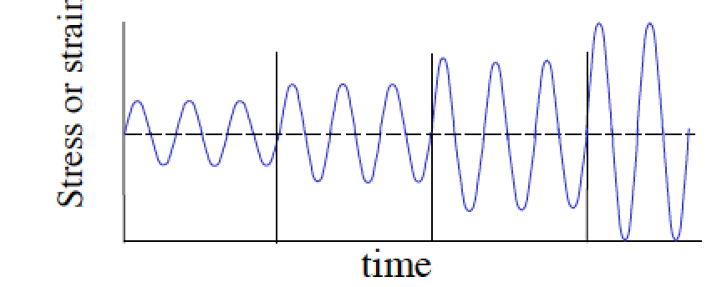
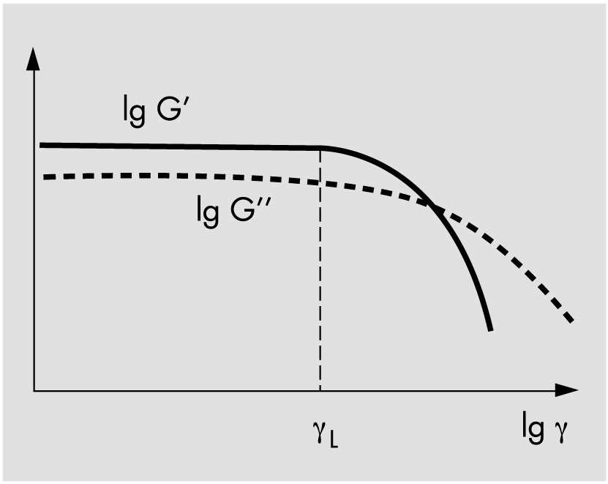
Practical oscillatory mesurements
Define the linear viscoelastic range, using a strain sweep:
This defines the range of amplitude
we can use for the test.
From TA instruments slides

Slide 32
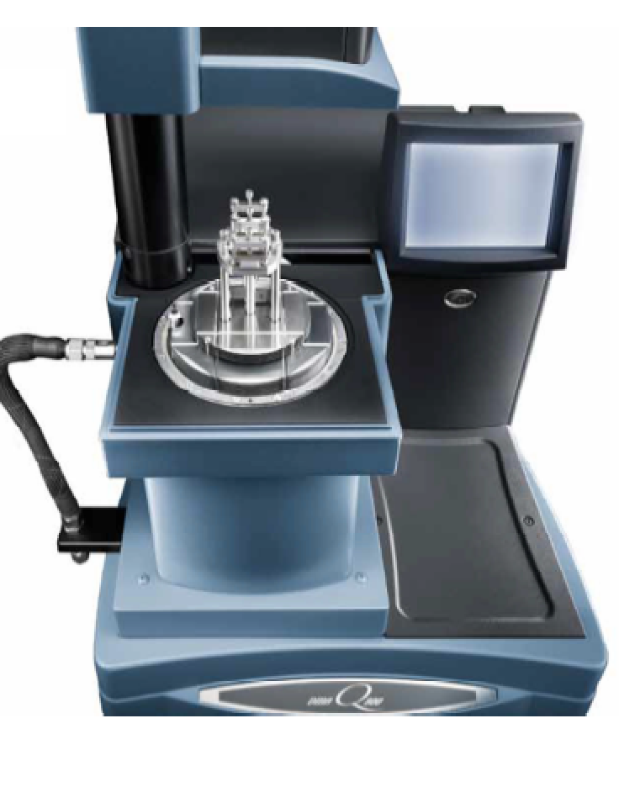
Practical oscillatory mesurements
Then perform the dynamic measurement, at a given temperature and/or frequency.
Example of equipment:
Dynamic Mechanical Analysis
From TA instruments slides

Slide 33
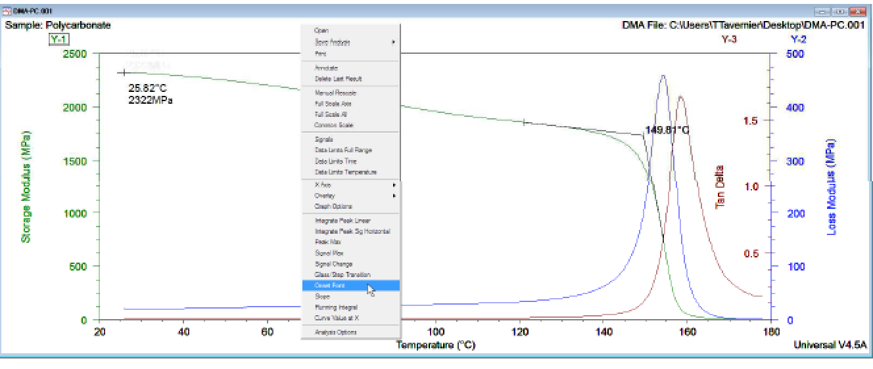
Practical measurements
Example: Polycarbonate

Slide 34
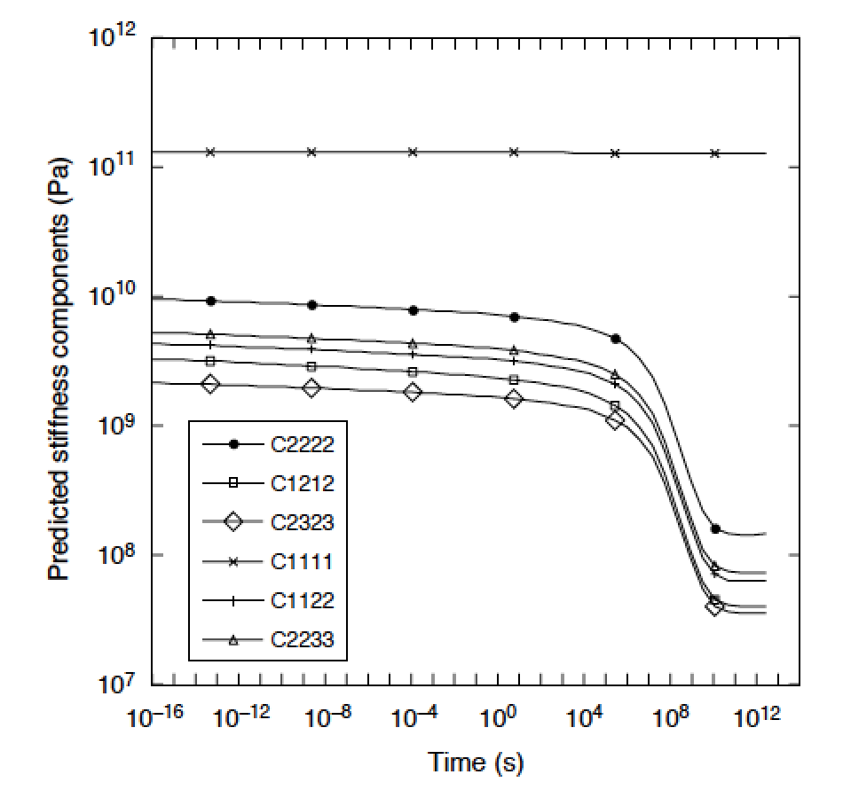

Time temperature superposition
Carbon-epoxy UD composite
Composite moduli, as a function of time, obtained through a time temperature superposition
From Clifford, Comp A 2005

Slide 35
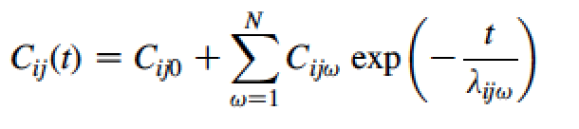
TTS Carbon-epoxy UD composite
Fitting of the curve, example of transverse modulus C2222, with a series of Maxwell models

Slide 36
TTS Carbon-epoxy UD composite
With 15 terms in the fitting, good agreement is obtained. This model can then be introduced in a Finite Element Model

Slide 37
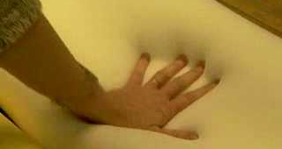
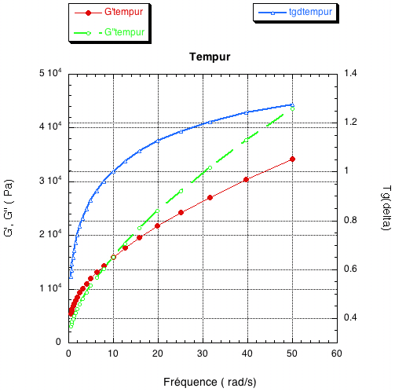
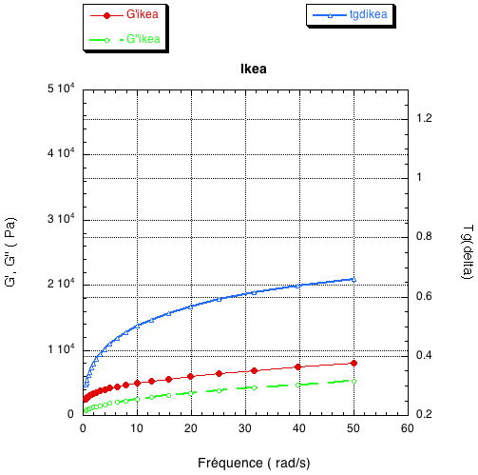
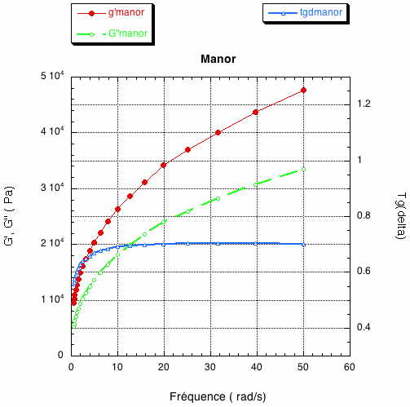
Other example: Which is the best pillow?
Viscoelastic pillows from Tempur, Ikea and Manor.
G’, G”, Tg δ as a fct of frequency.
What do we observe?

Slide 38
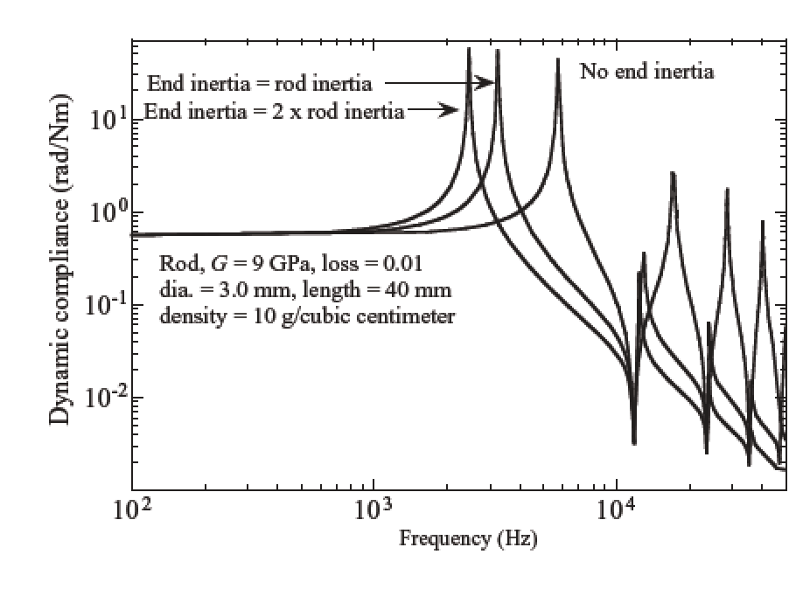
Other dynamic measurement techniques
Resonance methods: appropriate for low loss materials, tgδ<10⁻³. Instruments can be a torsion pendulum, or magnetic devices that vibrate the sample, generally fixed as one or both ends.
Inertia can become a problem.
From Lakes 2013

Slide 39
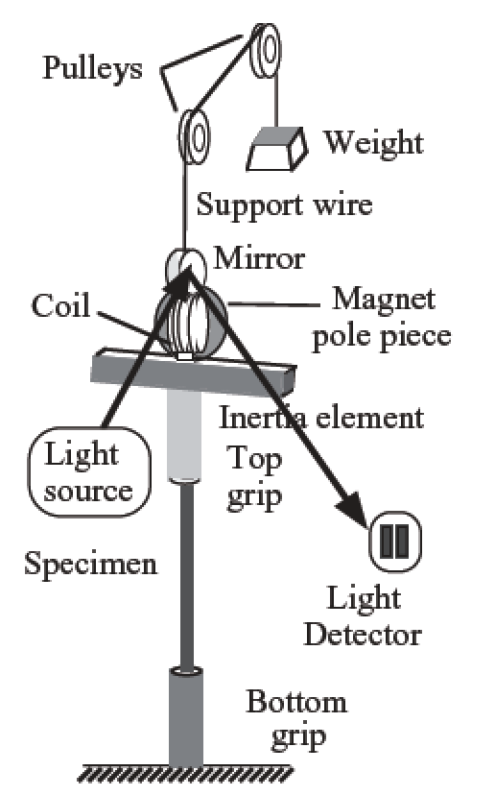
Other dynamic measurement techniques
Example of a driven torsion pendulum.
Torque on the coil is pole piece
generated by the action of a magnetic field supplied by a permanent
magnet (one pole piece shown)
From Lakes, 2013

Slide 40
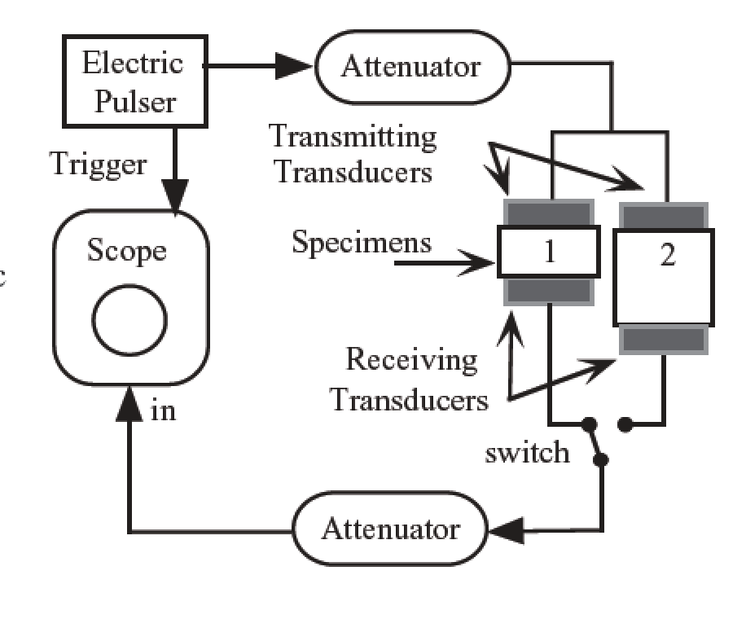
Other measurement techniques
Indentation testing can be used, for creep or dynamic testing, at small scales or for surface coatings.
Attenuation of ultrasonic waves can also be used

Slide 41
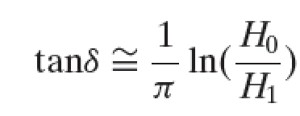
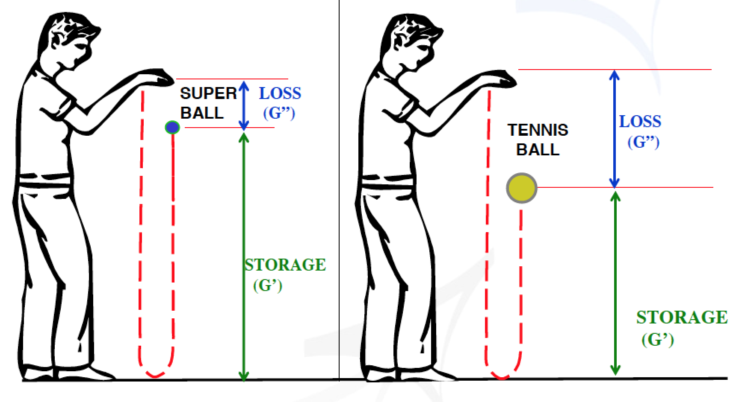
A simple dynamic measurement technique
Rebound test, drop at H1, rebounds to H0, approximate relation:

Slide 42
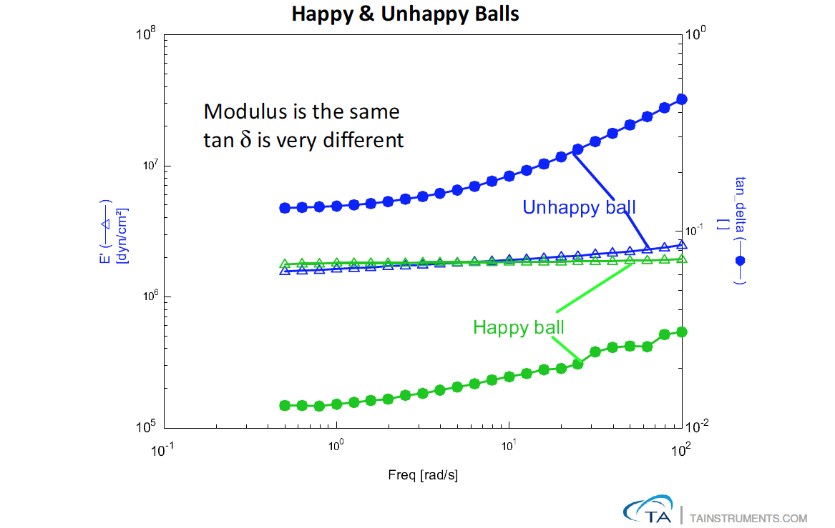
Which ball has the best rebound?

Slide 43
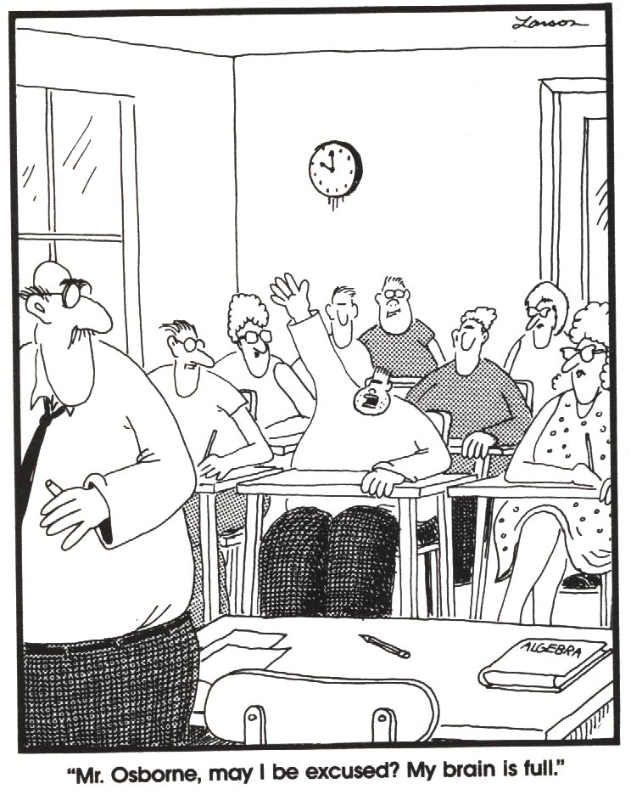
Conclusion
Viscoelastic materials exhibit a time dependent behaviour
Methods to characterize this behavior are simple static experiments, or dynamic subresonant or resonant methods.
To obtain the behavior of the material over several decades of time or frequency, the equivalence between time and temperature is generally used.
Take home message: when dealing with polymers or soft matter, do not trust one value of modulus, but always consider the time frame of the testing method as well.
See you this afternoon at the DMA.

Slide 44
Some References
Viscoelasticity of engineering materials, Y.M. Haddad, Chapman & Hall, 1996.
Viscoelastic solids, R. S. Lakes, CRC press, 2009 (available as e-book as well, 2013 edition).
Ferry, J. D., Viscoelastic Properties of Polymers
Ward, I. M. and Hadley, D. W., Mechanical Properties of Solid Polymers

